Slide 1
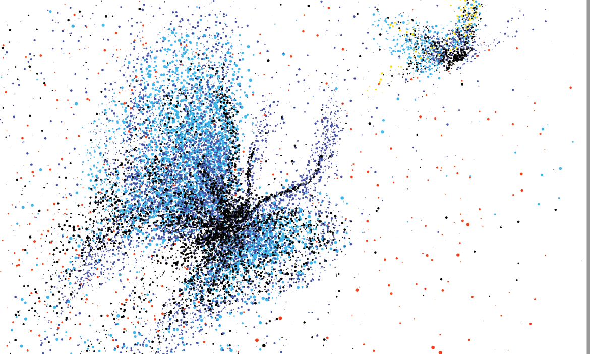

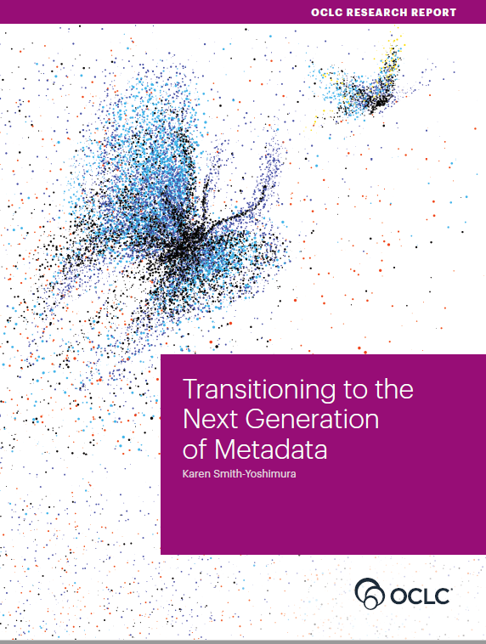
RLP Works in Progress W19 November 2020​
Transitioning to the Next Generation of Metadata

Slide 2


Speakers
Karen Smith-Yoshimura
OCLC Research Senior Program Officer
Helen K. R. Williams
Metadata Manager, LSE Library

Slide 3
OCLC RLP Metadata Managers Focus Group – Report fodder
62
Partners in 11 countries
777
Pages of response compilations
93
Hours of discussion
Notes:
First, some background on the OCLC Research Library Partners Metadata Managers Focus Group. The 62 research institutions represented on the Metadata Managers Focus Group includes ten in the UK and Ireland, and Helen is one of the Focus Group members. The discussions and responses to question sets over the last six years (2015 -2020) provided the fodder for the Transitioning to the Next Generation of Metadata report.

Slide 4
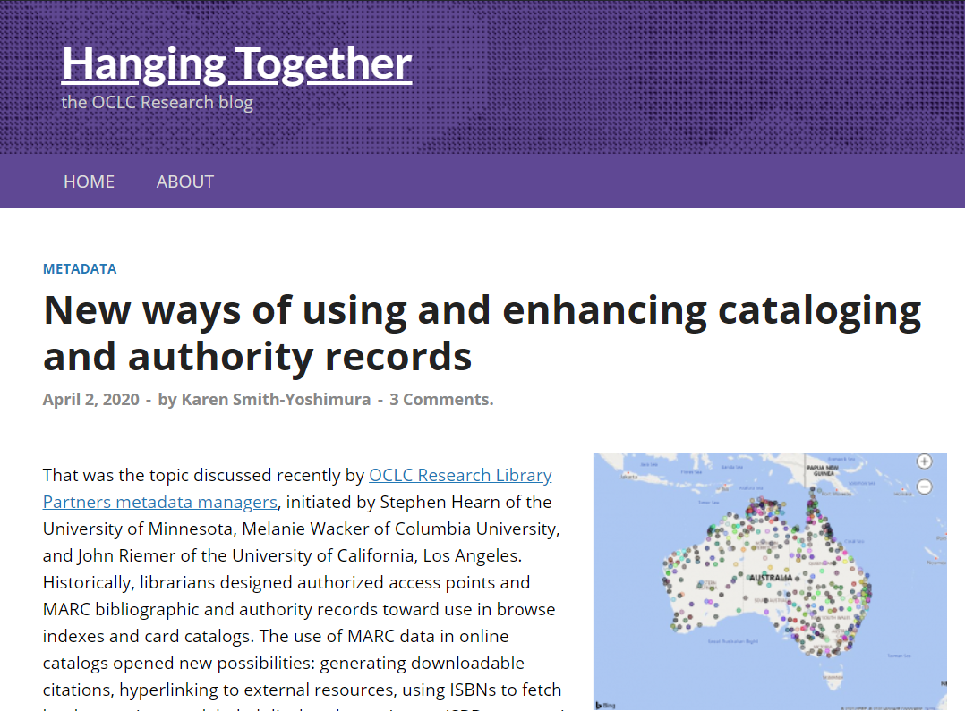
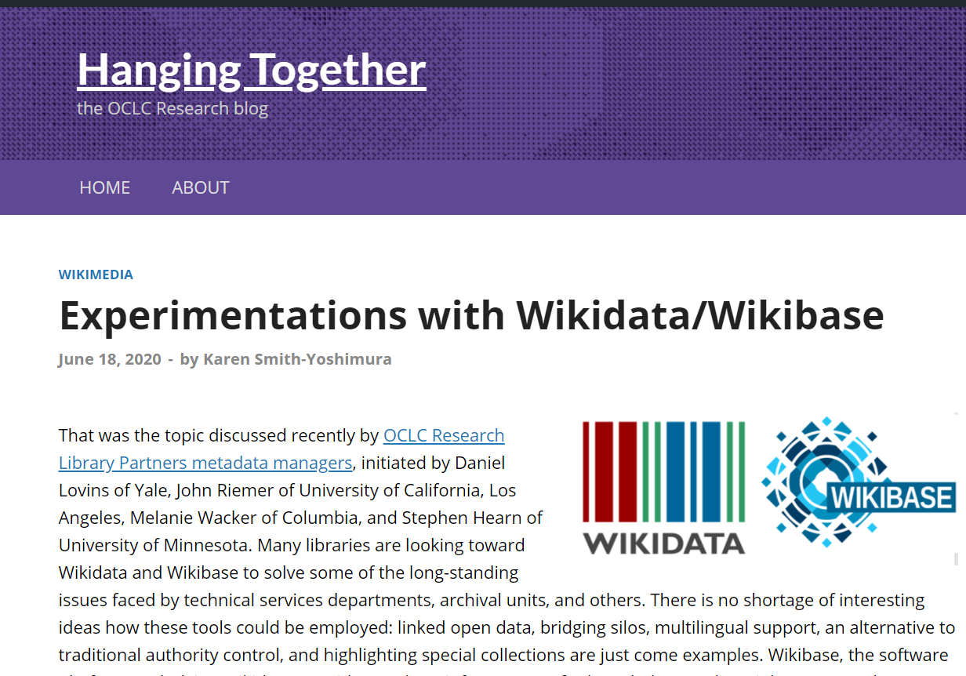
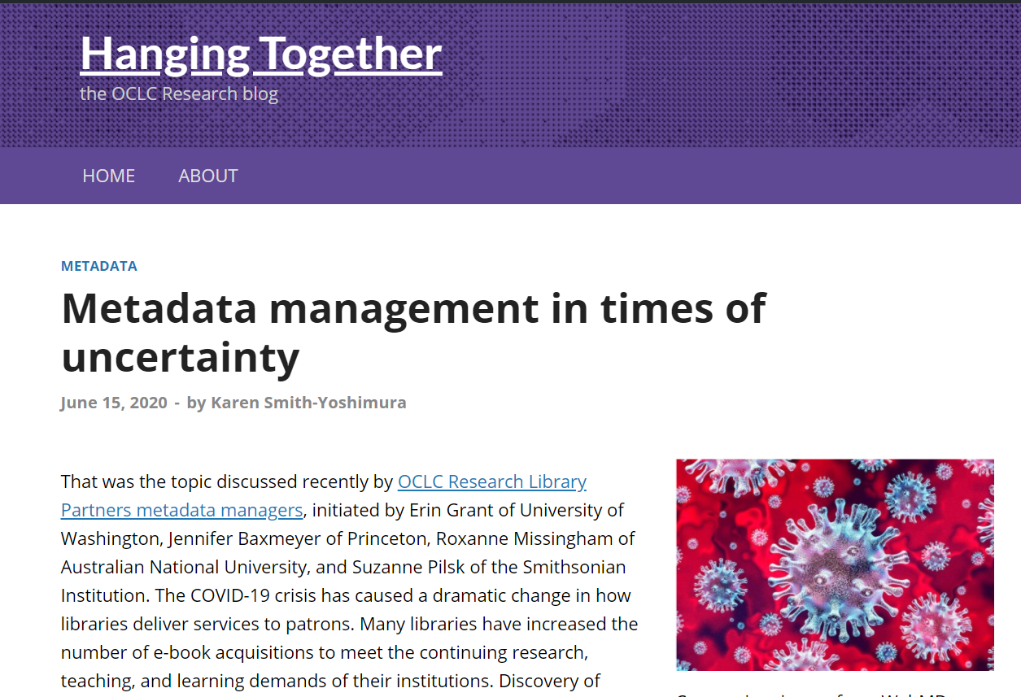
36 HangingTogether Blog Posts summarizing discussions
https://hangingtogether.org/
Notes:
All the discussions and Focus Group responses were summarized on our HangingTogether blog, 36 of them in this six-year period.

Slide 5
The Transition to Linked Data and Identifiers
Describing “Inside-Out” and “Facilitated” Collections
Evolution of “Metadata as a Service”
Preparing for Future Staffing Requirements
Impact
(48 pp, 148 citations)
Notes:
And I did a “meta-synthesis” of all of them and categorized them into these five sections in the report, which Helen reviewed. The report includes 148 citations, not just to the HangingTogether blog posts, but to other OCLC Research reports and references the Focus Group members included in their responses to question sets. I will briefly highlight some key takeaways in each of these sections, and Helen will provide the UK context for each.

Slide 6
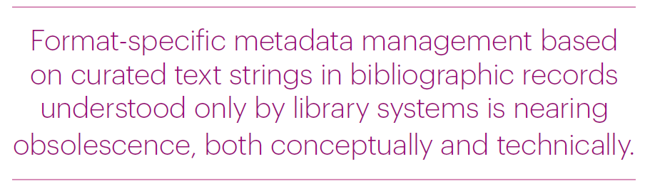
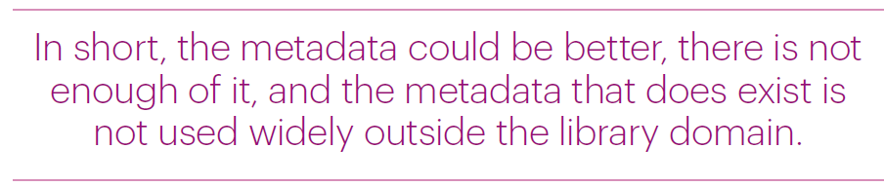
Context
Notes:
This quotation from the report’s introduction is an underlying theme of Focus Group discussions, reinforced from the British Library’s Collection Management Strategy 2019-2023 “Traditional methods of metadata generation, management and dissemination are not scalable or appropriate to an era of rapid digital change, rising audience expectations and diminishing resources.” (https://www.bl.uk/bibliographic/pdfs/british-library-collection-metadata-strategy-2019-2023.pdf)
Another theme is a frustration of the state of current metadata.

Slide 7

Context
Metadata for collections and research outputs
For local communities &
the wider world
Contributing to the global web of data
Notes:
Firstly, thank you very much to Karen for the opportunity to speak alongside her on the report she’s authored.
Many of the trends in the report were raised at the UK’s Future of Cataloguing events held during 2019.
In drawing out the UK context I’ll cover metadata for collections and research outputs in support of our local communities and the wider world, with a focus on how our metadata transition can contribute to the global web of data.
This will be a whistle-stop tour so there will undoubtedly be some things I don’t cover and some inevitable bias to work at my own institution. Please get in touch with me or with MDG if you’re aware of other relevant work – we are stronger when we collaborate so it’s always good to learn from and support one another. Links to everything I mention are at the end of the slides.

Slide 8
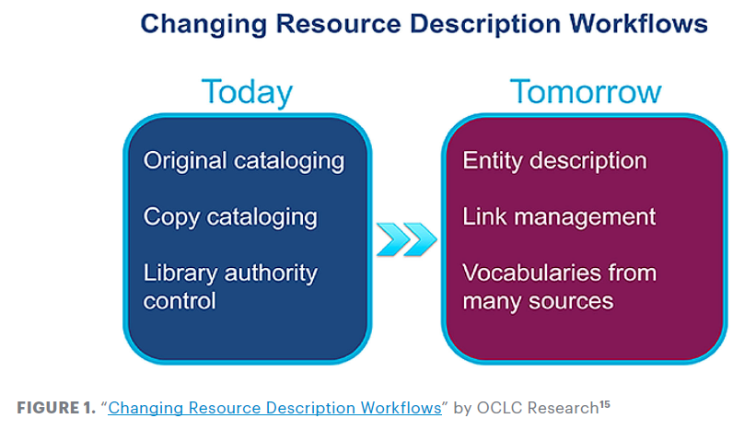
Transition to Linked Data & Identifiers
“Persistent identifiers were viewed as crucial to transitioning from current metadata to future applications.”
Notes:
Many Focus Group discussions focused on the changes taking place in the transition to linked data and identifiers.

Slide 9
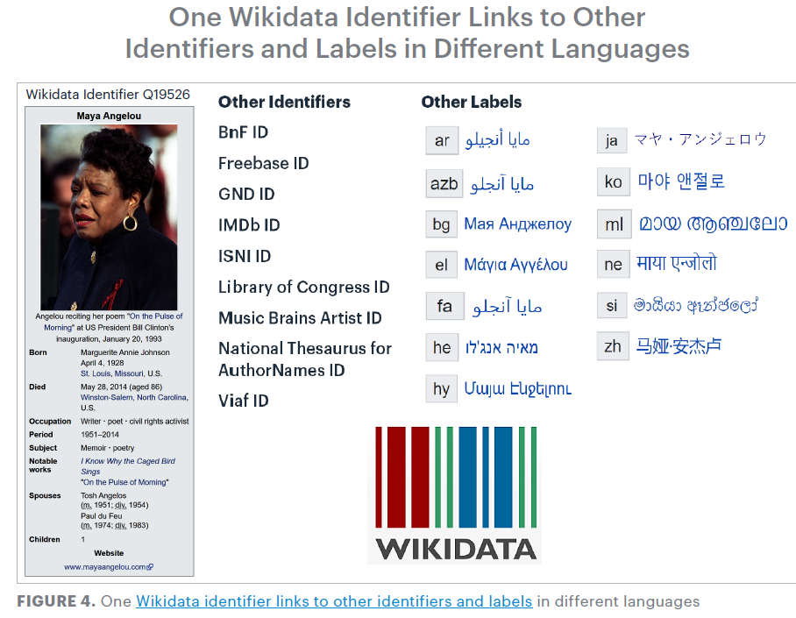
“Identity management poses a change in focus…to describing entities …and the relationships among them.”
Notes:
One of the shifts underway is from authority control to identity management, and the value of “identifier hubs” such as Wikidata to aggregate identifiers pointing to the same entity and also offering labels in different languages and writing systems.

Slide 10
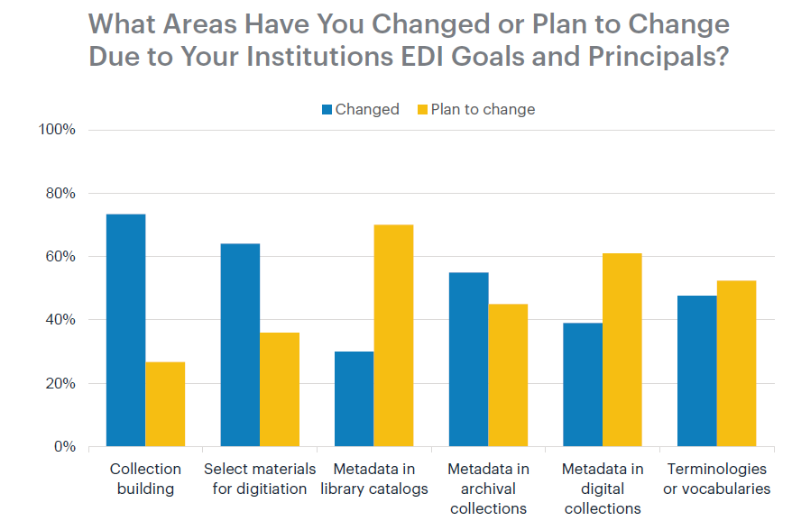
“Addressing language issues is important as libraries seek to develop relationships and build trust with marginalized communities.”
Notes:
When OCLC Research did a 2017 survey of the Research Library Partnership on Equity, Diversity, and Inclusion, metadata in library catalogs (third from left) lagged behind changes institutions had already changed in their workflows to comply with their EDI goals and principles. Ability to link to multiple vocabularies with different labels is a promising approach to address language issues.

Slide 11

Publisher metadata
BL working with 5 publishers to seed their metadata with ISNIs
BIC Metadata Capabilities Directory
Notes:
On the whole it seems that UK librarians have had less opportunities to be involved in the bigger kind of Linked Data projects that we follow in the US. But there’s a lot happening in the realm of identifiers. The report mentions British Library work with publishers to add ISNIs to publisher metadata so that identifiers appear earlier in the supply chain. And BIC have recently launched the Metadata Capabilities Directory. I think we can be hopeful this representation of how metadata is used across the supply chain will show where we can work together to seed metadata with useful identifiers and create more links.

Slide 12

Persistent identifiers
Towards a National Collection
Persistent Identifiers as IRO infrastructure
FREYA
BUT… No single identifier
covers all
use cases …
Notes:
Persistent identifiers are the basis of one of the projects of Towards a National Collection, which aims to bring collections together across institutional boundaries in the heritage sector, using identifiers.
FREYA has been running a bit longer – it’s an EU funded project, with the BL as a partner, aiming to extend the infrastructure of persistent identifiers in open research by building a graph that will link PIDs from different systems together, to support discovery of connections at least a couple of steps away.
But we see from this that no single identifier covers all use cases and so there’s still this need to support the creation of links and connections.

Slide 13



Wikidata
Identifier hub
Content in Linked Open Data ecosystem
Harvested by major discovery tools
Creates bridges across domains
    Examples: NLW Oxford Leeds Edinburgh Wellcome
Notes:
Karen mentioned Wikidata and there’s currently a lot of discussion around its potential as an identifier hub – from a library/research perspective think of bringing together identifiers such as ORCID, ISNI, LC, VIAF, Scopus, Microsoft Academic, Twitter, to name just a few.
Personally I’m really excited about the potential of Wikidata and the opportunities it offers to mint unique identifiers for the entities in our resources, pulling our content into the Linked Open Data ecosystem, and connecting it with unique identifiers from external knowledge systems. Google Knowledge Graphs, digital assistants such as Alexa and Siri, and Wikipedia Infoboxes are all populated with information harvested from Wikidata so content we create in it will impact search engine results and create bridges across currently siloed domains to make Library data more widely accessible, enabling new connections and discoveries.
At LSE I’m in the early days of creating experimental data models and thinking about how to scale up some manual work into a more automated project to add content to Wikidata but there are other UK colleagues who’ve been doing a lot more work in this area –
Jason Evans from the National Library of Wales has presented on using Wikidata to improve access to data, to improve data quality and to develop new tools and services for users.
Martin Poulter has blogged about his work at Oxford getting a whole variety of datasets onto Wikidata. He recently co-authored a UKSG article with Nick Sheppard at Leeds about Wikimedia and universities. Leeds have blogged about their Wikidata learning and how they drew on the expertise of Andrew McEwan at the University of Edinburgh. And finally, from a different angle, Harrison Pim, from the Wellcome has recently spoken about enriching their data with external content from sources such as Wikidata to connect works, people and concepts to improve search and discovery.

Slide 14

Knowledge Equity
IFLA’s WikiCite Discussion series
Session 5
Cataloguing Code of Ethics
Notes:
This potential of Wikidata to address knowledge equity is the focus of session 5 of IFLA’s recently produced WikiCite discussion series.
And there’s been a lot of collaborative work between colleagues in the UK, the US and Canada on the Cataloguing code of ethics. [As Richard Ovenden said this morning we have to be conscious of the new layers of knowledge we create through our metadata, and our responsibility for that].

Slide 15
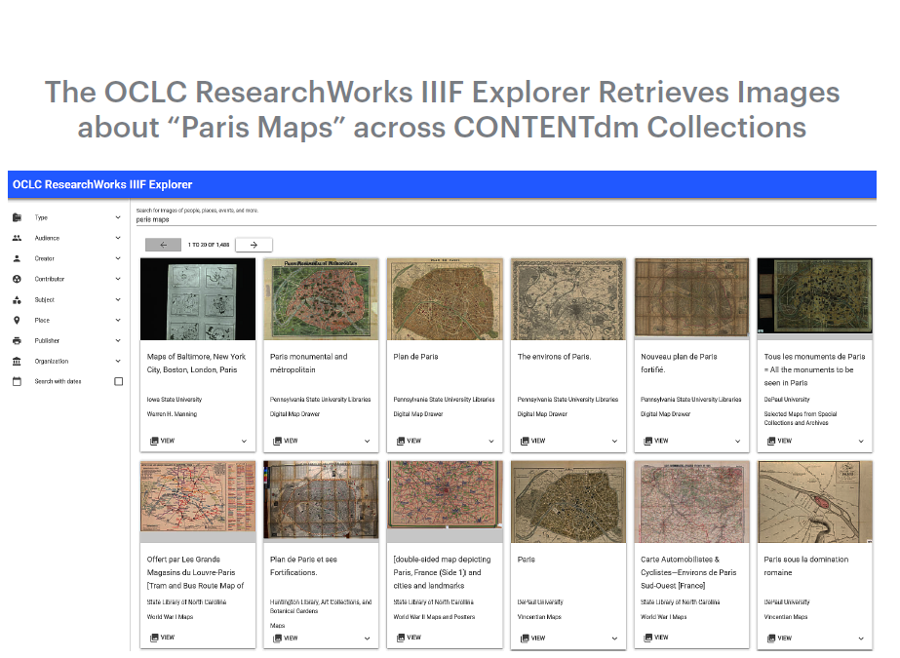
Describing “Inside-Out” and “Facilitated” Collections
Archival collections
Archived websites
Audio and video collections
Image collections
Research data
https://researchworks.oclc.org/iiif-explorer/
“Metadata underlies all discovery regardless of format, now and in the future…”
Notes:
The next section focused on specific challenges in describing the materials created and curated by institutions (Lorcan Dempsey’s “Inside-Out” collections), reflecting the firm belief that metadata underlies all discovery regardless of format, now and in the future. These are the five formats covered. Image collections provided an opportunity to highlight the ResearchWorks IIIF Explorer to showcase the wonderful opportunity to retrieve images across different institutions and collections.

Slide 16
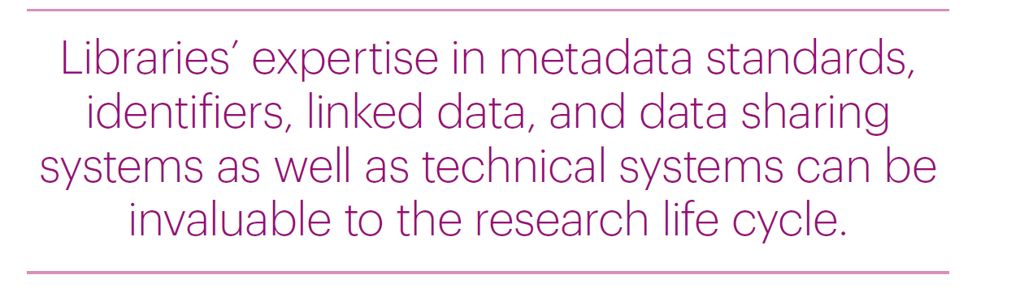

Slide 17

Access and quality
Quality of Shelf Ready Metadata
(NAG report)
National Bibliographic Knowledge Base (NBK)
Notes:
In providing access to facilitated collections we’re all very aware of the tension between timeliness and good quality description. NAG’s Quality of Shelf Ready Metadata report, prepared by Emma Booth, encourages libraries and suppliers to work together to ensure fit for purpose metadata to support discovery and use, and the NBK is a national bibliographic data infrastructure which can support us in shared cataloguing.

Slide 18


Plan M
“The changes in data availability, fitness-for-purpose (including eBook records) and coverage should start to enable libraries to regard the metadata associated with ‘routine acquisition’ as a solved issue, allowing them to focus on more bespoke work and describing special or hidden collections”
Notes:
The NBK supports the work of Plan M, which is seeking to streamline the bibliographic ecosystem in the UK. One of the outcomes of this anticipates that metadata associated with ‘routine acquisition’ will be a solved issue, allowing focus on metadata for our inside out collections.

Slide 19

Exposing unique content
Google Arts & Culture
Flickr
Unsplash
JSTOR Open Community Collections
Notes:
At LSE we’ve embarked on a piece of work I’ve called ‘Fit for Purpose metadata’ which looks, among other things, at how we can increase reliance on externally supplied records in order to create the capacity to engage with digital scholarship and linked data developments for our unique resources.
Colleagues in the Digital Library team have been experimenting with pushing unique content to various platforms - Google Arts and Culture, Flickr, Unsplash and JSTOR Open Community Collections, and I’ve been looking at how we can link these external platform collections with the Library via Wikidata.

Slide 20

Working with unique content
Archives Hub Names Project
International Image Interoperability Framework (IIIF)
Text Encoding Initiative (TEI)
Metadata support for research data
Notes:
Working with unique content tends to mean we’re outside the realm of traditional library name authority files, and the Archives Hub Names project is exploring how to process and match names to enable linking resources from different collections.
Unique content also often means we’re working with the different formats Karen’s highlighted. Jisc recently worked with LSE and UCL to explore using IIIF to ease cataloguing issues and bottlenecks in digitisation projects. And I’m aware that Manchester have developed expertise with TEI for work with their digital collections to provide rich, contextual metadata.
Research data is an emerging area of involvement for metadata colleagues - during lockdown the metadata team at LSE have carried out an audit of LSE datasets in external repositories to support our REF submission. Elsewhere metadata colleagues are sometimes involved in providing the metadata for internal research data repositories.

Slide 21
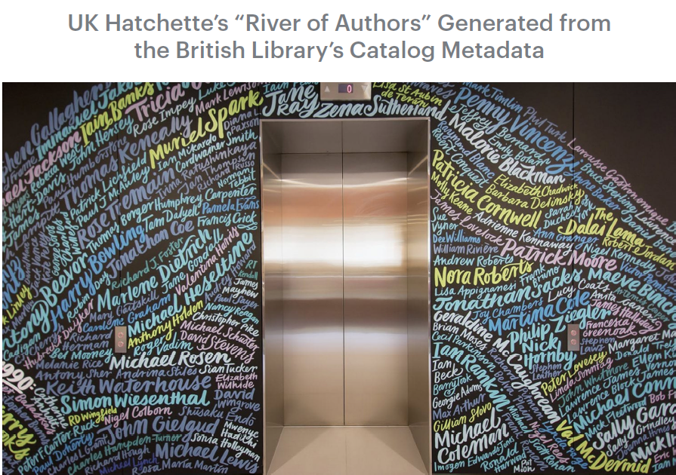
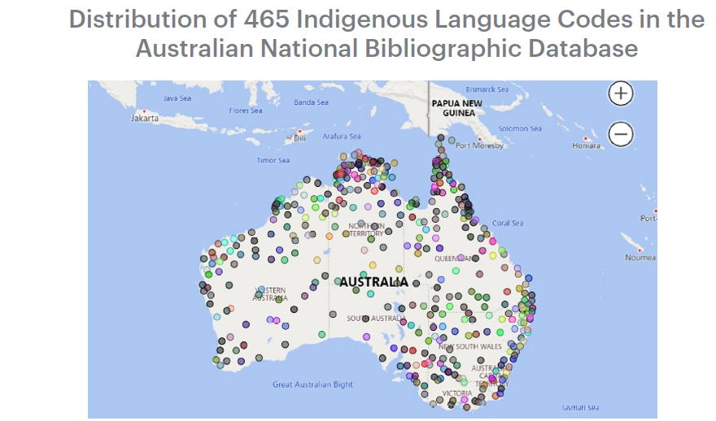
Evolution of “Metadata as a Service”
New applications
Bibliometrics
Plus:
Metrics
Consultancy
Semantic indexing
Notes:
We also covered uses of metadata beyond describing materials, “Metadata as a Service”. This included new applications, such as visualizing the distribution for different Australian aboriginal languages represented in the Australian National Bibliographic Database drawn from the language codes assigned (on the left) and bibliometrics supplied by the British Library to the UK Hatchette’s publisher group on their top authors represented in the BL’s catalog used to decorate their headquarters (on the right).

Slide 22


Metadata as a service
Collaborative partnerships
Metadata as a primary output
Notes:
The evolution of metadata as a service brings new opportunities for involvement and I’d encourage colleagues to be proactive in seeking those out.
Before lockdown I began a piece of work at LSE to review and reprioritise the work of the Metadata team to ensure we were supporting the changing needs of the library. As a result of this I’ve been seeking to reposition the team as a collaborative partner and also think about how we can establish metadata as a primary output in its own right, not simply as a supporting feature of other library services.

Slide 23

Cross team working
Research Support Digital Library
Data Management Plans JSTOR Open Community
Datasets audit Collections
REF support
Online services
Optimising library systems
Notes:
Lockdown has obviously had an unexpected impact on this, but we’ve been able to increase cross team working with the Research Support team, revive some involvement with Digital Library projects and plan work with the Online Services team as part of optimising library systems work.
Longer term I want us to look at collaborative partnerships to open up our metadata and expose it on the Web, and consider how collection metadata might be useful for research.

Slide 24

Catalogue as Data
Legacies of Catalogue
Descriptions and Curatorial Voice
Macroscopes and Microscopes:
Scholar Cyborgs in the Digital
Research Library
Notes:
The idea of the catalogue as data is a culture shift we’re beginning to see more. James Baker, at the University of Sussex has blogged about the Legacies of Catalogue Descriptions project looking at computational, critical and curatorial analysis of collection catalogues.
And Tim Hitchcock, also from Sussex, gave a fascinating presentation at RLUK 2019 about connecting scholars with bibliographic data for research.

Slide 25
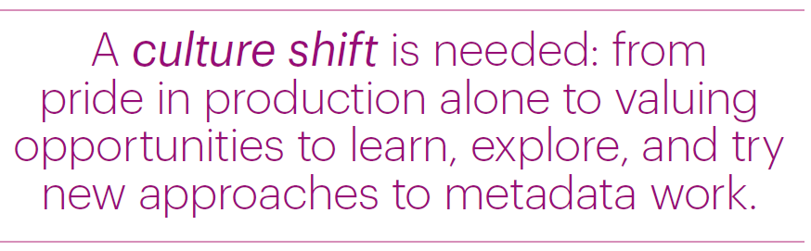
Preparing for Future Staffing Requirements
Notes:
The implications of the transition on staffing generated lots of discussion on the culture shift necessary, plus learning opportunities, the new tools and skills needed, self-education, and addressing staff turnover.

Slide 26


Culture shift
#RLUKdigishift
Notes:
RLUK in particular have highlighted the culture shift we’re seeing through their Manifesto for the Digital Shift in research libraries, and their new Digital Shift Forum.

Slide 27
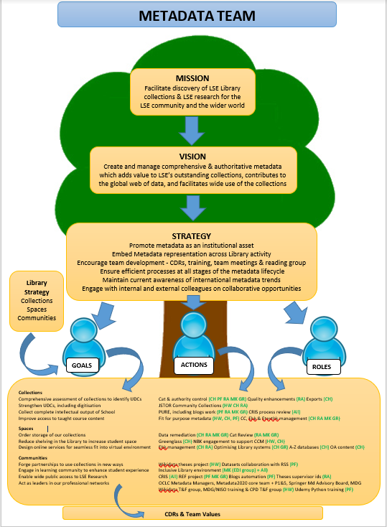
Metadata Team Purpose Tree
Notes:
In this environment it’s vital not only to know, but to show how metadata links with and supports our library and institutional strategies – at LSE we do that through a team purpose tree which shows where our work fits into the library strategy, in turn informed by institutional strategy.

Slide 28

Flexibility
Seek opportunities for
Metadata colleagues
to contribute to the
wider work of the Library
Notes:
Flexibility is absolutely key so that metadata colleagues can support the wider work of the library, and it’s always better to be able to offer your services than to be asked for your help! During lockdown colleagues in the Metadata team at LSE were able to get involved in reviewing Data Management Plans and that’s enriched their work in the Metadata team by giving visibility of an earlier part of the research process when they’re used to working towards the end of it.

Slide 29
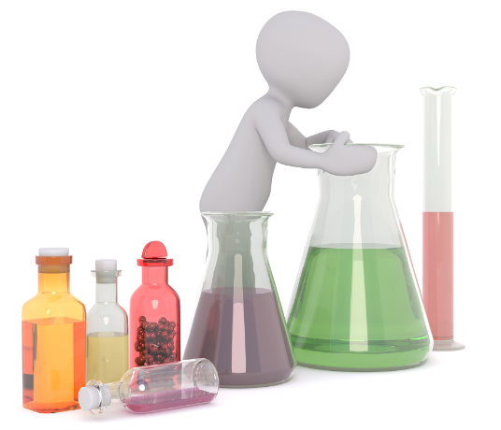
Reviews
Efficiencies
New opportunities
Experiments
Notes:
We also need to be prepared to carry out process reviews and seek out efficiencies. This year one of my team has been looking at how brief record rules in Alma might help us to spend less time reviewing metadata for teaching collections, and is hopeful we can shave 170 hours off the process a year. And we need to look at where we need new skills - another of my team is learning Python and has used new skills to further automate our blog metadata and some research support tasks. Time saved in the team is then repurposed to new and developmental work. My message as we navigate this culture shift in our libraries and transition to the next generation of metadata is don’t be afraid to experiment – that’s how we’ll learn and develop new skills to support our profession in the global sharing of data.

Slide 30


Impact
Notes:
The report concludes with the work underway at OCLC on the Shared Entity Management Infrastructure and the Focus Group’s expectation that it will address many of the challenges documented in the report around persistent identifiers, especially providing language-neutral links to trustworthy sources. A key take-away: Good linked data require good metadata!

Slide 31
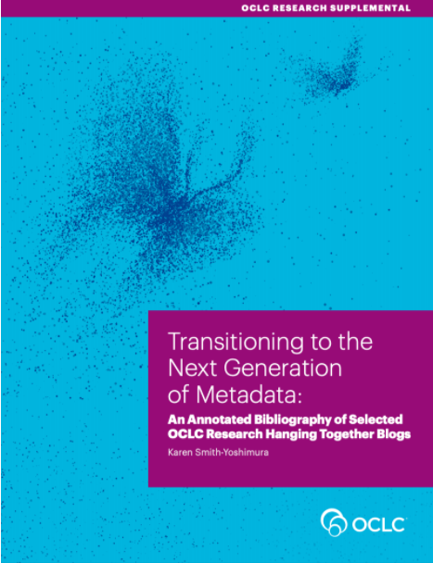
Supplement
https://oc.lc/nextgen-metadata-report
Notes:
We also published as a supplementary document to the report an annotated bibliography of all the HangingTogether blog posts cited in the report, organized to mirror the sections of the report, and providing more details on each.

Slide 32

Transitioning to the Next Transitioning to the Next Generation of Metadata 19 November 2020
Thank you!
Contacts:
Karen Smith-Yoshimura
smithyok@oclc.org (until 30 November 2020)
@KarenS-Y
Helen K. R. Williams
H.K.Williams@lse.ac.uk
@HelsKRW

Slide 33
Links to referenced articles, blogs, projects (1)
Slide 6
British Library. 2019. Foundations for the Future: The British Library’s Collection Metadata Strategy 2019-2023. London: British Library. https://www.bl.uk/bibliographic/pdfs/british-library-collection-metadata-strategy-2019-2023.pdf. (accessed 21st Oct 2020)
Slide 7
Aburrow-Jones, Natasha and Paul Cunnea. 2019. The Future of Cataloguing: A CIG Scotland World Café Workshop. Catalogue and Index (196). pp. 27-33. https://cdn.ymaws.com/www.cilip.org.uk/resource/collection/0E92069B-94A5-4749-B3E3-A32037C69EE7/ci_196_aburrow-jones_cunnea_future_cataloguing.pdf (accessed 21st Oct 2020)

Slide 34
Links to referenced articles, blogs, projects (2)
Slide 10
Smith-Yoshimura, Karen. 2020. Transitioning to the Next Generation of Metadata, Dublin, OH: OCLC Research, p12. https://doi.org/10.25333/rqgd-b343 (accessed 19th Oct 2020)
Book Industry Communication. 2020. BIC Metadata Map. https://www.bic.org.uk/195/BIC-Metadata-Map/ (accessed 9th Nov 2020)
Slide 11
Towards a National Collection https://www.nationalcollection.org.uk/ (accessed 19th October 2020)
Persistent Identifiers as IRO infrastructure https://www.nationalcollection.org.uk/projects (accessed 19th October 2020)
FREYA https://www.project-freya.eu/en (accessed 19th Oct 2020)

Slide 35
Links to referenced articles, blogs, projects (3)
Slide 12
Evans, Jason. 2020. Creating and Enriching Linked Data with Wikidata. CILIP Metadata & Discovery Group conference 2020. https://www.youtube.com/watch?v=RApW2x4KJfw (accessed 19th Oct 2020)
Poulter, Martin. 2019. Wikidata: GLAM/Oxford. Wikidata. https://www.wikidata.org/wiki/Wikidata:GLAM/Oxford (accessed 19th Oct 2020)
Poulter, Martin and Nick Sheppard. 2020. Wikimedia and Universities: Contributing to the Global Commons in the Age of Disinformation. Insights 33 (1): 14. http://doi.org/10.1629/uksg.509 (accessed 19th Oct 2020)
Sheppard, Nick. 2019. Wikimedia in Universities. Leeds University Library blog, 1 Feb 2019. https://leedsunilibrary.wordpress.com/2019/02/01/wikimedia-in-universities/ (accessed 19th Oct 2020)
Wikimedia UK and the University of Edinburgh. 2020. Wikimedia in Education. https://open.ed.ac.uk/wikimedia-in-education/ (accessed 19th October 2020)
Pim, Harrison. 2020. Concepts, Wikidata etc. Wikidata and Cultural Heritage Collections, Science Museum Heritage Connector webinar. 19th Jun 2020. https://www.youtube.com/watch?v=kZGcnL8gI6Y (accessed 19th Oct 2020)

Slide 36
Links to referenced articles, blogs, projects (4)
Slide 14
IFLA. 2020. WikiCite Discussion Series. https://www.youtube.com/playlist?list=PLV81siTMahbsjakNDIdFwbIvdyNqwRNPo (accessed 19th Oct 2020)
Cataloging Ethics Steering Committee. A code of ethics for catalogers. https://sites.google.com/view/cataloging-ethics/home (accessed 19th Oct 2020)
Slide 17
Booth, Emma. 2020. Quality of Shelf-Ready Metadata: Analysis of Survey Responses and Recommendations for Suppliers. National Acquisitions Group. https://nag.org.uk/wp-content/uploads/2020/06/NAG-Quality-of-Shelf-Ready-Metadata-Survey-Analysis-and-Recommendations_FINAL_June2020.pdf (accessed 19th Oct 2020)
Grindley, Neil. 2019. Driving Transformation with the NBK – where have we got to and where next? Jisc. https://libraryservices.jiscinvolve.org/wp/2019/01/nbktransformation/ (accessed 19th Oct 2020)

Slide 37
Links to referenced articles, blogs, projects (5)
Slide 18
Grindley, Neil. 2019. Plan M – definition and direction. Jisc. p4. https://libraryservices.jiscinvolve.org/wp/2019/12/plan-m/ (accessed 19th Oct 2020)
Slide 19
LSE Library on Google Arts & Culture https://artsandculture.google.com/partner/lse-library (accessed 19th Oct 2020)
LSE Library on Flickr https://www.flickr.com/photos/lselibrary/ (accessed 19th Oct 2020)
LSE Library on Unsplash https://unsplash.com/@londonschoolofeconomics (accessed 19th Oct 2020)
LSE Library on JSTOR Open Community Collections https://www.jstor.org/site/london-school-of-economics/ (accessed 26th Oct 2020)
Slide 20
Stevenson, Jane. 2020, Names Project. Archives Hub. Jisc. https://blog.archiveshub.jisc.ac.uk/category/names-project/ (accessed 21st Oct 2020)
Findlay, Peter. 2019. Changing Digital Workflows with IIIF and Semantic Web Tools (report). Jisc. https://digitisation.jiscinvolve.org/wp/2019/12/04/changing-digital-worksflows-with-iiif-and-semantic-tools-report/ (accessed 19th Oct 2020)

Slide 38
Links to referenced articles, blogs, projects (6)
Slide 24
Baker, James.2020. Legacies of Catalogue Descriptions and Curatorial Voice: Opportunities for Digital Scholarship. https://cataloguelegacies.github.io/ (accessed 19th Oct 2020)
Hitchcock, Tim. 2019. Macroscopes & Microscopes: Scholar Cyborgs in the Digital Research Library. RLUK conference 2019. https://www.rluk.ac.uk/rlukplayer/ (accessed 19th Oct 2020)
Slide 26
RLUK. 2020. Digital Shift. https://www.rluk.ac.uk/digital-shift/ (accessed 19th Oct 2020)
Slide 27
Purpose Tree Model adapted from a diagram used by Tim Fuller of The Reality Business on LSE Introduction to Leadership Programme. http://www.realitybusiness.co.uk/the-team/ (accessed 11th Nov 2020)
Photo credits
Slides 7, 10-12, 14, 17, 18, 20, 22-24, 28, 29, CC0, 3dman: Pixabay
Slide 26, RLUK CC BY-NC-SA 4.0
Slide 27, Helen Williams

