Slide 1
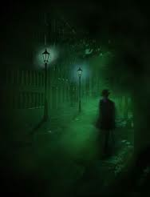
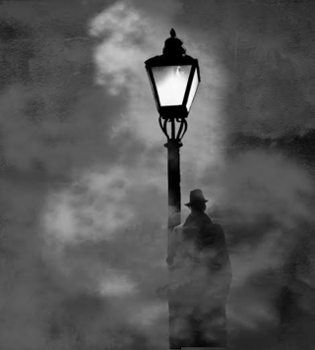

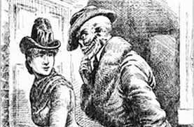
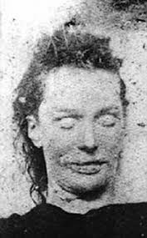
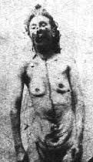

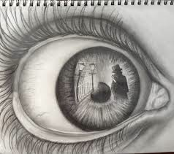
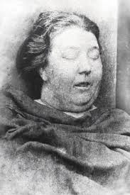
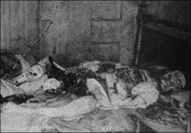
WANTED
Methodology
12 Jack the Ripper Tours.
10 weeks.
Restrictions and Reflections
Crowd behaviour.
Blending in.
Tour Goers and Typologies
History Buffs.
Tourists.
Ripper Heads.
Spiritualists.
Death Denying, Defying and Deriding
Dark side of Human Nature.
Morality and Mortality.
Real or Ripper-off?
Celebrities.
The New JTR.
History re-made.
Education or ‘Edutainment’?
Performance Techniques.
Gimmicks.
Historical accuracy
By Ella Britton

