Slide 1
Keynote Presentation
University of Thessaly, Greece
Saturday 17th October 2015
Simon Hayhoe
Canterbury Christ Church University / London School of Economics and Political Science, UK

Slide 2
Why do we think that blind people cannot understand visual arts?
Philosophical biases and critical duality

Slide 3
A question: What is possible to explain to a person born blind?
What can blind people understand? What don’t blind people understand?

Slide 4
Esref Armagan: a painter born totally blind
Esref is a Turkish man, who was born without function in his eyes. Thus he has no visual imagination or experience. He is responsible for the paintings on the previous slide.

Slide 5
How did Esref learn to draw and paint?
He was born without the use of his eyes, into a working class family with little education
He was not sent to school – it was unusual for blind children from his area of Turkey to attend school’s for the blind
He was not told he could not draw or paint
He drew because there was little else to do
He became bored and asked people what was around him
He drew items on card to understand them

Slide 6
Drawing on card gave him a tactile line, he could use to understand lines and concepts understood as visual
He asked people about the visual elements of the things that he drew
He incorporated these things into his drawings
He was told about colour, shade and foreshortening
He began to incorporate these into his paintings and images

Slide 7
Critical Dualism & Critical Proof
Karl Popper’s theory on the ontology and epistemology of facts and social norms from Protagoras

Slide 8
Karl Popper on Plato’s ideas on laws
At the time of Protagoras, some 500 BC, there was a debate on the nature of laws – these were divided into human laws and natural laws
Popper referred to these as “facts” and “norms”
These two forms of phenomena can be illustrated as follows:
  Human laws:
    It is wrong to steal (Social norm)
  Natural laws:
    The sun rises in the east and sets in the West (Natural fact)
    In 2015, many British people believe it is wrong to steal (Sociological fact)
  Popper, K. (1966). The open society and its enemies: Volume 1 The spell of Plato (5th Edition). London: Routledge.

Slide 9
Critical dualism problematised
Empirical dichotomy
Biased dichotomy
Human Laws
Natural Laws
Natural Laws
Human Laws

Slide 10
How do academics define creativity, artistic Imagination and the institution of museums
Traditional visual biases of creativity, imagination and art institutions

Slide 11
Two traditional Philosophical schools of thought on blindness
The Metaphysists
  membership examined the metaphysical joining of visual art, nature, aesthetic purity and direct sensory experience
The Percpetualists
  membership examined the scientific representation of sensory data as material perception
  this is what we now call cognition and intellectual comprehension
  Hayhoe, S. (In Press). Philosophy as disability & exclusion: The development of theories on blindness, touch and the arts in England, 1688-2010. Charlotte, North Carolina: Information Age Publishing.

Slide 12
The Metaphysicist: 15th Century philosophy of Da Vinci
“The eye which is called the window of the soul is the chief means whereby the understanding can most fully and abundantly appreciate the infinite works of nature; and the ear is the second, which acquires dignity by hearing of the things the eye has seen. If you, historians, or poets, or mathematicians had not seen the things with your eyes, you could report but imperfectly of them in writing. And if you, O poet, tell a story with your pen, the painter with his brush can tell it more easily, with simpler completeness, and less tedious to follow. If you call painting dumb poetry, the painter may call poetry blind painting. Consider then which is the more grievous defect, to be blind or dumb?” (P.190)
Da Vinci, L. (T. Wells, Ed.). (2008). Leonardo da Vinci notebooks. Oxford: Oxford University Press.

Slide 13
Descartes: The original Perceptualist
In the early years of the 17th Century, Descartes philosophised light was beyond metaphysics and was learnt
Like Galileo he was criticised by the Vatican for his belied
He also proposed that a blind person’s use of a cane was similar to a distillation of colours on objects
Descartes felt that colour was a property of light - it was interpreted in much the same way that a blind person could tell the identity of different objects
Hayhoe, S. (In Press). Philosophy as disability & exclusion: The development of theories on blindness, touch and the arts in England, 1688-2010. Charlotte, North Carolina: Information Age Publishing.

Slide 14
Boyle: colour as natural law
“That after the Blind man had four or five times told the Doctor the ſeveral Colours, (though Blinded with a Napkin for fear he might have ſome Sight) the Doctor found he was twice miſtaken, for he call'd the White Black, and the Red Blew, but ſtill, he, before his Errour, would lay them by in Pairs, ſaying, that though he could eaſily diſtinguiſh them from all others, yet thoſe two Pairs were not eaſily diſtinguiſh'd amongſt themſelves, whereupon the Doctor deſir'd to be told by him what kind of Diſcrimination he had of Colours by his Touch, to which he gave a reply, for whoſe ſake chiefly I inſert all this Narrative in this place, namely, That all the difference was more or leſs Aſperity, for ſays he, (I give you the Doctor's own words) Black feels as if you were feeling Needles points, or ſome harſh Sand, and Red feels very Smooth.” (P.45)
Boyle, R. (1664). Experiments and considerations touching colours. First occasionally written, among some other essays, to a friend; and now suffer'd to come abroad as the beginning of an experimental history of colours. Downloaded from http://www.gutenberg.org/files/14504/14504-h/longess.htm.

Slide 15
Locke: perception and metaphysics defined
“[A] blind man I once talked with, who lost his sight by the smallpox when he was a small child [had] no more notion of colours than one born blind. I ask whether anyone can say this man had any ideas of colours in his mind, any more than one born blind? And I think nobody will say that either of them had in his mind any idea of colours at all…
[The] truth is, ideas and notions are no more born in us than arts and sciences, though some of them indeed offer themselves to our faculties more readily than others and are therefore more generally received, though that too be according as the organs of our bodies and powers of our minds happen to be employed: God having fitted men with faculties and means to discover, receive, and retain truths, accordingly as they are employed.” (pp. 41–42)
Locke, J. (J. W. Yolton, Ed.). (2001). An essay concerning human understanding. London: Everyman Library / J. M. Dent.

Slide 16
Berkeley: The empirical testing of Locke
This concept was tested by Bishop Berkley, who studied a boy born blind who gained his sight through surgery
  The boy was unaware of what he had felt before, but built an understanding through touching what he saw
  Hayhoe, S. (In Press). Op. Cit.

Slide 17
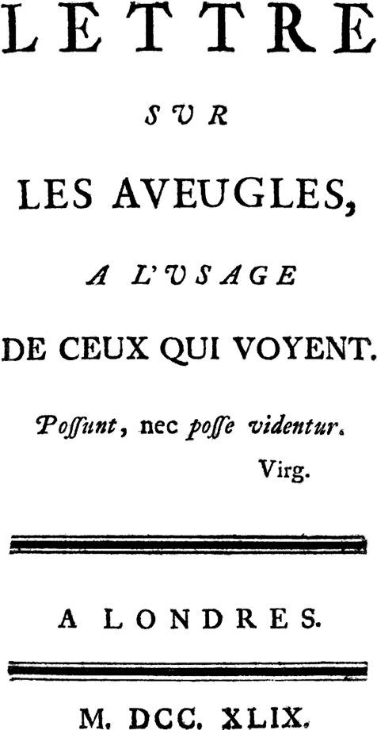
Diderot’s Essay on the Blind for Those Who See (first published 1749)
“Our virtues depend so much on the sensations we receive, and the degree by which we are effected by external things… [Yet,] Madam how different is the morality of the blind man from ours? And how different would that of a deaf man from his? And how to one with an extra sense, how deficient would our morality appear – to say nothing more? Our metaphysics and theirs agree no better.”

Slide 18
Hume: perception as the only experience
“If I comprehend the Author's Doctrine, which, I own, I can hitherto do but imperfectly, it leads us back to innate Ideas. This I do not advance as an Objection: For nothing ought ever to be supposed finally decided in Philosophy, so as not to admit of a new Scrutiny; but only that, I think, the Author affirms I had been hasty, & not supported by any Color of Argumen[t] when I affirm, that all our Ideas are copy'd from Impressions. I have endeavoured to build that Principle on two Arguments. The first is <a Detail> desiring any one to make a particular Detail of all his Ideas, where he would always find that every Idea had a correspondent & preceding Impression. If no Exception can ever be found, the Principle must remain incontestible. The second is, that if you exclude any <I> particular Impression. . . as Colours to the blind, Sound to the Deaf, you also exclude the Ideas. ” (P. 416)
Wood, P. B. (1986). David Hume on Thomas Reid's An Inquiry into the Human Mind, On the Principles of Common Sense: A New Letter to Hugh Blair from July 1762. Mind, 95(380), 411-416.

Slide 19
Question
So, were the Perceptualists discovering natural laws or repeating social norms?
What was the effect of this philosophy?

Slide 20
Twentieth century philosophies of arts and museums
Philosophy built into our modern philosophical consciousness

Slide 21
contemporary studies of blindness and arts
Most contemporary studies of blindness and arts focus on the perception of objects and “real things”, such as Perception and Metaphorical visual language
They do not examine:
  the nature of aesthetics
  the motivation for creative and imaginative activity
  why art is important to people who are blind
Argument: Contemporary epistemology hails largely from previous eras and biased empirical studies
  Hayhoe, S. (In Press). Op. Cit.

Slide 22
Gombrich on visual art as natural law
“Art educators sometimes try to make us feel guilty for our failure to use our eyes and to pay attention to the riches spread out before us. No doubt they are occasionally right, but their structures do little justice to the difference between seeing, looking, attending and reading, on which all art must rely.” (Gombrich, 1984: P. 95)
Gombrich, E. (1984). The sense of order: Studies in the psychology of decorative art. London: Phaidon Press.

Slide 23
Bourdieu on museums as natural law
““I wanted to be able to tell myself I’d done the museum, it was very monotonous, one picture after another. They ought to put something different in between the paintings to break it up a bit.” (engineer, Amiens, aged 39, Lille Museum). These comments are reminiscent of those of the conservator of the New York Metropolitan Museum, who sees his museum as “a gymnasium in which the visitor is able to develop his eye muscles.”” (P. 269)
Bourdieu, P. (2010). Distinction. London: Routledge Classics.

Slide 24
Revesz’s study on arts and blindness as natural law
“[From] what sources could a blind person, who has never seen the world with all its wealth of forms and color, derive those manifold experiences?... [No] one born blind is able to become aware of the diversity of nature and to apprehend all the rich and various appearances of objects.” (pp. 316–17)
Revesz, G. (1950). Psychology and art of the blind. London: Longmans, Green.

Slide 25
Two Case studies of blind arts learners
Student at RNIB New College, Worcester & Teachers at the Metropolitan Museum of Art, New York

Slide 26
Anna
Student at RNIB New College, Worcester, UK

Slide 27
Anna: Student preparing for art college
Anna was early blind, in her late teens, and had attended mainstream school as a young child and then New College as an early teenager
She only moved to New College when her sight deteriorated substantially and her mainstream school could no longer support her.
She extreme tunnel vision and total colour blindness
In the latter stages of compulsory education, she had little problem with her art classes
Hayhoe, S. (2008). Arts, culture and blindness: Studies of blind students in the visual arts. Youngstown, New York: Teneo Press.

Slide 28
Anna: often within expected social norms
“During her Christmas holiday, Anna plans to take more black and white pictures. She says, “I really, really enjoy it.” She also says that she would spend three hours after school in the dark room in New College if she had to, as the project is that important to her. Anna also said that it gives her real senses of achievement when she gets an image right the way she wants it.
Anna shows me a series of black and white photographs that she took during her previous half-term holiday. This series is of what she considers to be interesting faces of people she either knows or found in London. She says that she particularly enjoys [her] images of old men with teeth missing.”
(S. Hayhoe, observation notes)

Slide 29
Anna: however, tested norms using colour
“I always found art difficult in mainstream because of my colour vision, or lack of. You know I was always having to ask people what colour things were, like paints. With my pens and pencils, however, I usually labelled them up and then took them into school, so I knew what colour was what. When it came to mixing paints and things I had real trouble. And I’ve never been very good at using paints, because I can’t even see when paints have run into each other on the actual painting. And sometimes they can turn out a real mess. That got easier through towards GCSE. I was more independent, I could more, tell more easily, you know, what colours that I was using. Probably because I got used to recognising them.”
(Anna, personal communication)

Slide 30
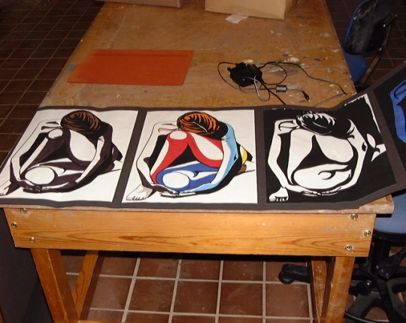
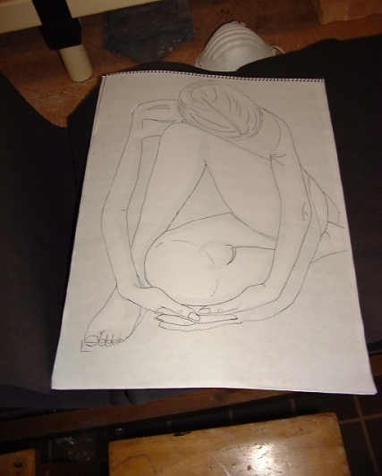
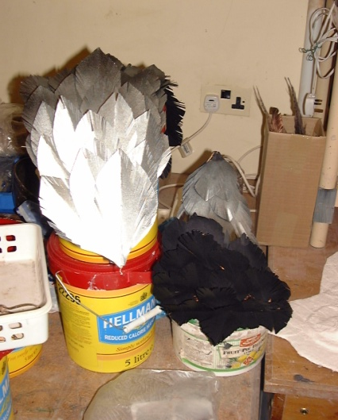
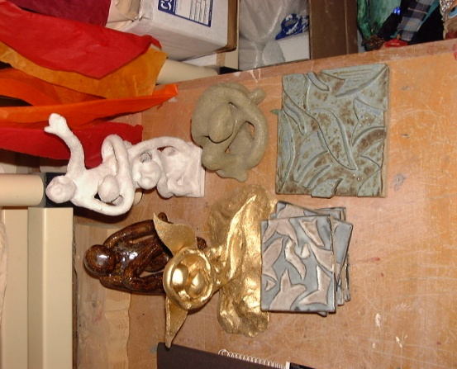
Anna: art adapted to incorporate colour

Slide 31
Carmen
A sighted verbal imaging teacher at the Metropolitan Museum of Art, New York, US

Slide 32
Carmen: Teacher at the Metropolitan Museum
A Spanish teacher who had first come to the US to study, and stayed
She was an art historian by training, and had studied for a PhD, but never completed
Teaching thirty years at the Met – since 1981
Taught people who were blind and visually impaired for between 20-25 years
Hayhoe, S. (2015). An enquiry into passive inclusion and unreachable artworks at the Metropolitan Museum of Art, New York: Three case studies of verbal imaging teachers describing artworks in galleries and classrooms. Paper presented to the conference Blind Creations 2015, Royal Holloway College, University of London, Egham, Surrey, UK, 28-30 June 2015.

Slide 33
Carmen: Challenges to her social norms
Carmen: The first person I taught was totally blind. And I fell in love with the way of teaching. I was not supposed to be doing it. I was a lecturer and I was asked to show up to guide somebody who was blind, and they asked me if I would go. And I never forget the first picture I [described], it was a Rubens. It was a picture of himself, his wife and his child. And to me it was a miracle, because the person was totally blind and they started asking me questions. And I realised that I was looking at the picture for the first time…
Me: Were they asking about colour?
Carmen: Colours, brush work, and parts of the picture – and this is a picture that I know very well because it is right in my field, 17th Century – they would ask me things and I would say “it is a nice day,” and then they would say “so the sky is blue, or it has a few clouds” and I would tell myself that I had never seen the clouds before. And they would say “on top of their heads there is sky?” And I would look up and I would say, “oh, there is a pergola.” And I would say [to myself] thirty years and I have never seen the pergola.

Slide 34
Carmen: experience of verbal imaging
“Doing verbal imaging is a guide for me. They are my guide. They are the ones that ask the relevant questions. They are the ones that guide me through the picture.”
Me: So later blind people, what kind of things will they say [referring to older people who have lost their sight]…?
Carmen: I find them very different. Many of the people who come to the museum who have macular degeneration, I find that they want to almost imprint the picture into their minds… I had this wonderful woman, who we’d worked with her for years and years, and she was always making photos of art. Everything [was] perfect, so she would say, “Do I remember well that the flowers are on the work? Were the flowers really pink like I remember?””

Slide 35
Carmen: the particularities of language
“Me: Is there a difference between the questions a person who is blind will ask you and a person with sight will ask you, beyond [the questions of perception]
Carmen: [People with sight] have much lower expectations. People with sight, they don’t see anything. With people with sight we tell them, “Stop!” With my gallery talks I say, “take two minutes to look at the picture.” Because nobody looks at pictures… That’s why I worry about people, that they don’t see…” For me, it’s like they are all blind, I have to teach them how to see.”
“Me: For [people who are blind] is it more about the technical aspects of the painting, the historical era, the setting?
Carmen: I find that there is a combination… Different people, who are sighted and blind, are interested in different things... I just don’t see much difference to be honest with you.”

Slide 36
Carmen: Addendum to Hume - The importance of environment
“Carmen: I always want to bring the [blind person] in front of the picture. This is because I want them to know what distance they are… It is the ambience, it is the smell. It is the noise. It is the other people, the other reactions. And I really do think that when you have them [blind visitors] in front of the work of art there is a connection, not just the eyes… There’s a reason I don’t want to see El Greco on a print. It’s worse. I need to be in front of El Greco to see the work. That’s what moves me. I don’t want to cheat somebody who is blind and show them a print.”

Slide 37
Conclusions
Secondary Findings – Passive Inclusion in the Museum

Slide 38
Three primary conclusions
Previous literature has focused too heavily on the understanding that inclusion in the museum is premised primarily on touch, and therefore “purely” visual concepts cannot be understood
Case studies show Perceptualists and Metaphysicists are wrong: concepts are not specific to inherent knowledge or individual perceptions
Blind people should be included in all aspects of visual culture, with an understanding that they are capable of developing the conception through language and environment

